Slide 1
Time Transfer and Ensembles Across Moving Platforms
Presented by Marc Weiss Marc Weiss Consulting
marcweissconsulting@gmail.com
With Thanks to Charles Barry, Luminous Cyber Co And to Steven Wilkinson, Raytheon Technologies

Slide 2
Outline
Precision Time and Frequency
What is it? What are the needs and uses?
GNSS are vulnerable
Time Sync can help reduce over-dependence on GNSS
Principles of Time Transfer
One-way vs Two-way time transfer
Time transfer across moving platforms
Relativistic effects
PNTP
Time Scale Ensembles
General principles, example algorithms
Advantages and Challenges
Distributed Ensembles
Ensembles across moving platforms
Conclusions: Research Ǫuestions
How to optimally estimate delays among randomly moving platforms?
How to generate an ensemble time more stable than all member clocks even when they are very diverse?
Can ensembles of ensembles provide improved resilience and performance?
How best to account for clocks entering and leaving ensembles?

Slide 3


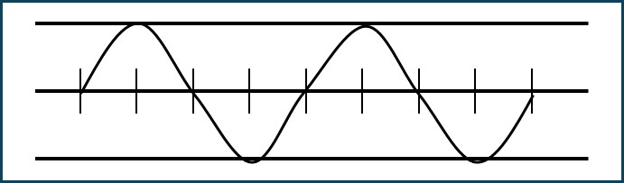
Time and Frequency Sources
Frequency is fundamental. A clock produces a frequency by realizing principles of physics plus noise.
Time is an artifact. A time signal is produced from frequency by counting cycles. All clock times walk off from each other without bound.
UTC is the international reference. Local time can be steered to UTC.
3

Slide 4
Comments about Time
Not the time that we directly experience as human beings
The time that we create as engineers and scientists.
An artifact. We completely make it up
The Time Standard (hours-minutes-seconds, year-months-days) is totally a human-created thing
The labels we put on the 1-PPS pulse are arbitrary
We count cycles of frequency in clocks
Our time standard is meant to approximate the “t” for time in our scientific equations. But that “t” is generally meant to be idealized: noise free and perfectly sequential

Slide 5
Two Issues Here
Since a clock is a frequency device, the best clock possible exhibits only white noise on frequency, hence a random-walk in phase. Even the best clocks will walk off unboundedly in time.
Since the time standard is artificial, time MUST be transferred from the relevant time standard
Transferring time requires
A signal, providing the on-time pulse or a clock frequency
Data, giving the date (hour-minute-second, year-month-day, etc)
Often what is needed is synchronization among locations, not UTC per se, though that is often the most efficient way to achieve sync

Slide 6
Time Signal Plus Data
Time Distribution
Receiving Node
Async time msg: 05:00:00.000000 10/31/2014 Z
After reception of Both, the receiver knows the time is
1. 05:00:00.000000
10/31/2014 Z, after receipt of the async data
2. Plus, xxx ns upon receipt
of on-time marker
Physical On-Time Marker

Slide 7

Time and Frequency Transfer: How to Deliver a Timing Reference
Time Transfer Accuracy Requires Calibrating Delays
Imagine writing a letter: “It is now 2 PM– set your watch”
Seal it in an envelope and drop it in a mail box
Only useful if you know how long it took to get to you
Now suppose you timestamped when you sealed the letter and the receiving person timestamped when he got it…
And that you had accurate clocks!
Time Stability = Frequency Accuracy

Slide 8
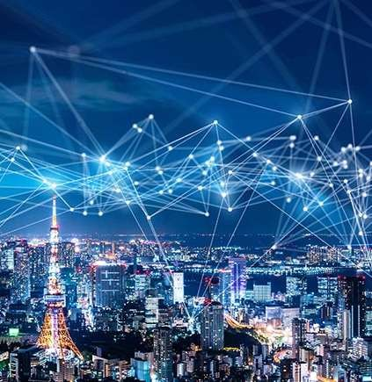

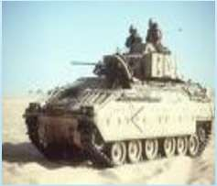

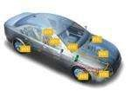

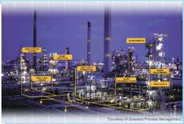
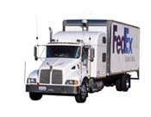
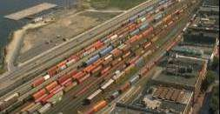
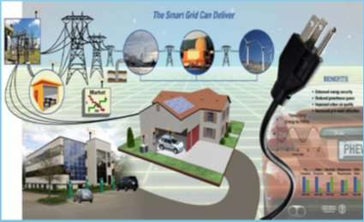
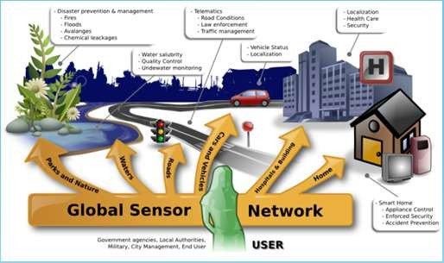
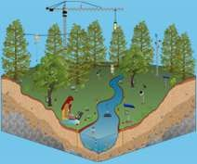
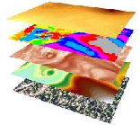
Some Current Applications that Need Precision Time
Defense
Agriculture
Telecom
Industrial Automation
Transportation and Connected Vehicles
Smart Grid
Enable New Knowledge
Smart City
Source: Cisco (flavio@cisco.com)

Slide 9
Systems that Benefit from Precise Time
Telecom systems
Multiplexing
Packet networks
Wireless access
Optimal use of wireless spectrum
Broadcast services, such as Audio-visual transmission
Electric Power Grid
Data Centers
Financial Services
Location-based services
1 ns = 1 foot
Cyber-Physical Systems (CPS)
Local systems
Global systems
Temporal determinism in software
Optimizes energy usage and resource allocation
Supports CPS timing (sensing to actuation)
Allows increased regulation in trades
Time stamping of events
Correlation for analysis
Data aggregation
Many, many more…

Slide 10
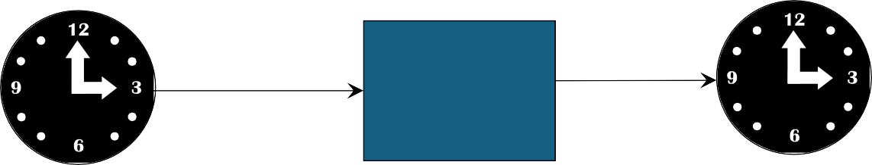
One-Way Dissemination or Comparison System
Clock 1
Clock 2
Clock 1 Systematics
Clock 2 Systematics
Delay, Perturbations, and
and Noise
Measurement Noise
and Noise
One-way Time Transfer requires determining and removing the Delay
Slide - 10

Slide 11
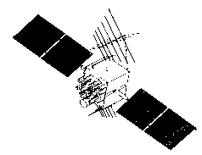
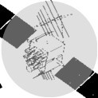

One-Way Time Transfer: GPS
UTC
System Time
Satellite signal is locked to the on-board atomic clock. Receiver can obtain time
Satellite Vehicle (SV) Clock
and frequency of atomic clock from the RF signal.
Ephemeris error
50 Hz data channel gives the offset of:
Clock time from GPS time
the offset of GPS time from UTC
Ionosphere
Troposphere

Slide 12
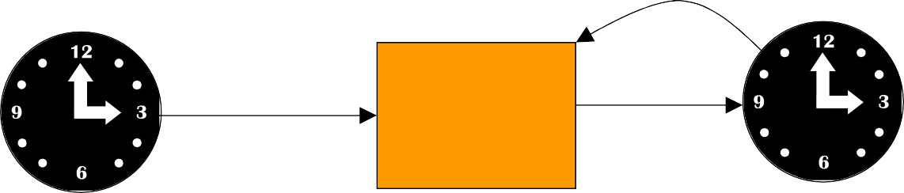
Clock 2 locked to Clock 1
Clock 1
Clock 2
Clock 1 Systematics and Noise
Clock 2 Systematics and Noise
Lock Loop Systematics and Noise: Contributions from
Measurement Noise and Path Perturbations
Slide - 12

Slide 13
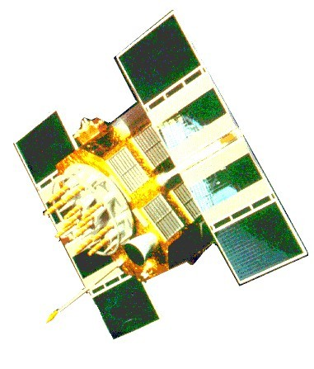
GNSS-aided Time and Frequency Systems: Lock Local Oscillator to GNSS
T/F System
Ǫuartz Crystal Oscillator
GNSS
GNSS
Rcvr
Compare
Tune
Qz Osc.
Output Time aFnredqF. req.
Or
GPS
Rcvr
Rubidium Vapor
Atomic Oscillator
Compare
Tune
Rb Vapor Phy Pkg
Qz Osc.
Output Time
and Freq.
T/F System
Courtesy H. Fruehauf, ViaLogy LLC

Slide 14
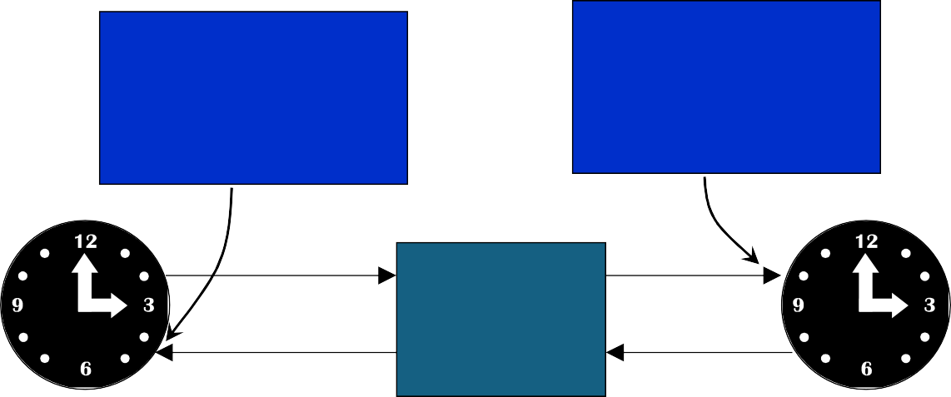
Two -Way Comparison System
Measure t₁₂= Clock1-Clock2
+d₁₂
Measure t₂₁= Clock2-Clock1
+d₂₁
Clock 1
Clock 2
Clock 1 Systematics
Clock 2 Systematics
Two-way transfer depends on
and Noise
the Path being Reciprocal:
and Noise
^{d}12 ^{= d}21
Slide - 14

Slide 15
Two-Way Time Transfer: Four Time Stamps
Client
Server
T1 09:00:000
T2 09:00:005
T3 09:00:015
T4 09:00:025
Time
Time
Corrected time 09:00:0225

Slide 16
Security and Resilience
A lot of work has been done on cybersecurity, but security of timing is still developing
Since timing is both signal and data
Security of data is like cybersecurity
Security of timing signal is new to cybersecurity:
does the signal come from the true source?
has the signal been interfered with?
Resilience in time transfer generally means redundancy of systems
Time accuracy, UTC, most commonly comes from GNSS, which is vulnerable
to interference. Though one can have a direct connection to a source of UTC,
a national lab

Slide 17
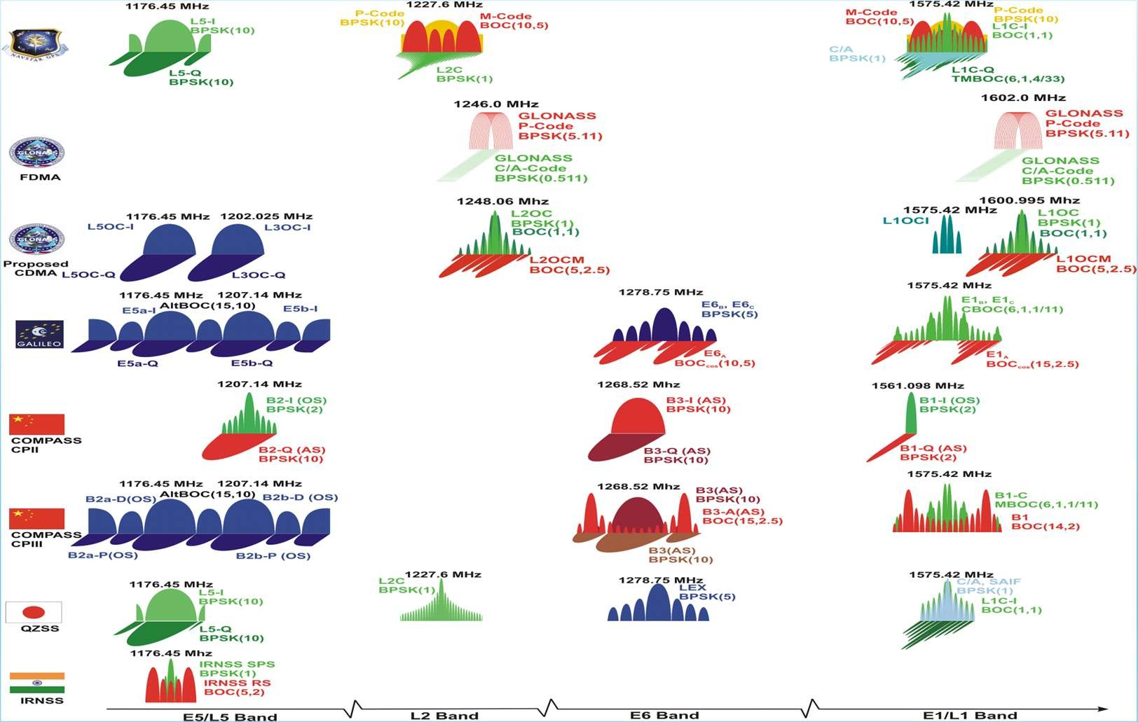
Spectra of GNSS Signals– Vulnerability
Primary Commercial Signal
Slide 17

Slide 18
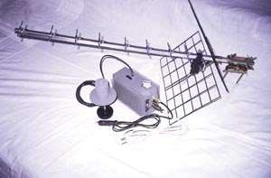
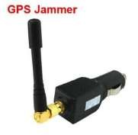


GNSS Vulnerability: Jamming
GNSS best feature and worst problem: it is extremely reliable
Jamming Power Required at GPS Antenna
On order of a Picowatt (10⁻¹² watt)
Many Jammer Models Exist
Watt to MWatt Output – Worldwide Militaries
Lower Power (<100 watts); “Hams” Can Make

Slide 19
GNSS Vulnerability: Spoofing/Meaconing
Spoof – Counterfeit GNSS Signal
C/A Code Short and Well Known
Widely Available Signal Generators
Meaconing – Delay C Rebroadcast
Possible Effects
Long Range Jamming
Injection of Misleading PVT Information
No “Off-the-Shelf” Mitigation
100
Correlation %
L P E
Code Phase (t)
100
1. Match Real Code
Correlation %
L P E
Code Phase (t)
100
2. Capture
Correlation %
L P E
Code Phase (t)
Spoof Code GPS S.V. Code
3. Pull Off
Successful Spoof

Slide 20
Time Without GNSS
Systems generally only need UTC for coordinating with distant systems, or with systems run by competitors
Generally, a system only needs time coordination across clocks participating in that system
Hence, time-transfer is critical
Alternate-PNT systems have been designed for self-consistent PNT

Slide 21
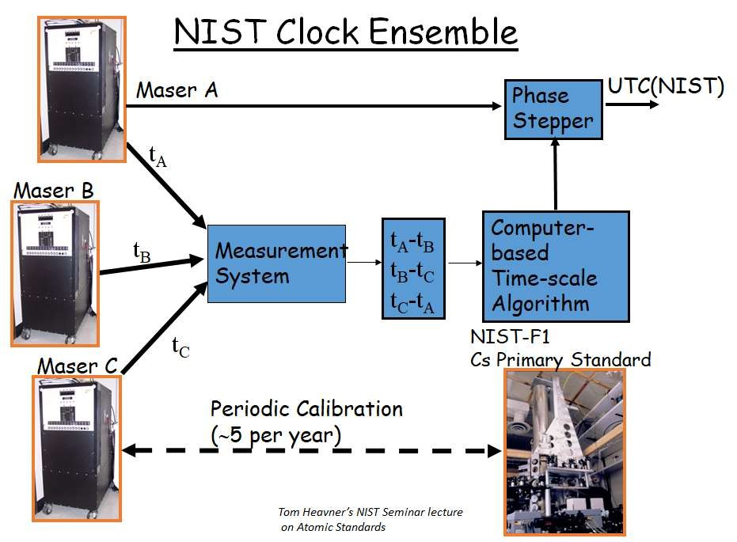
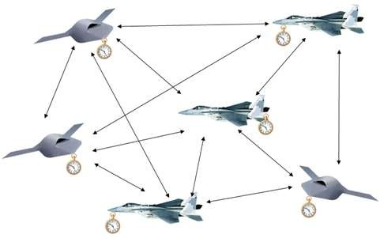
Visual Summary: Stationary vs Dynamic clock ensembles
Can we use ensemble techniques to create an optimal dynamic network timescale?
?
21

Slide 22
Remote clock synchronization
GPS is the best clock synchronization system ever built.
Time transfer is a method to synchronize two or more remote clocks to share the same time.
Clock synchronization is a means to maintain time across a network when an external reference like GPS is unavailable
Stationary clock ensembles have been used internationally in national labs to generate an improved reference time across global synchronized clocks, i.e. International Atomic Time (TAI) and Universal Coordinated Time (UTC)
Can we create a clock ensemble for dynamic platforms in a denied environment?
22

Slide 23
























Clock Synchronization
Architectures
Plesiochronous Strategy (Anarchy) Free-running (Current GPS
Master-Slave
Strategy (Despotism)
Links are continuous or periodic
method each clock updated independently)
M
M
Master-Slave
Strategy (Despotism)
M-S1,S6, S1-S2, S2-S3, S6- S5
This configuration has latency
Mutual Strategy (Democracy) Links are continuous or periodic Anyone can be the master
All can run an ensemble algorithm

Slide 24
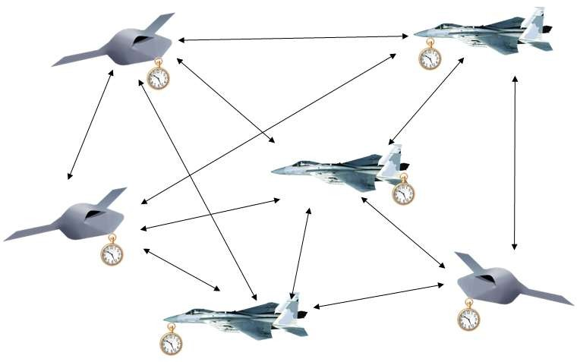
Time synchronization across a dynamic network
When GPS is denied we can establish a common time that is maintained across a stationary or dynamic network
For dynamic clocks motion correction is required due to relativity and to measure propagation delay :
in a gravitational field clock rates are dependent on position and velocity and are different across the network
propagation time asymmetries between platforms
For precision synchronization (nanosecond errors) between platforms the following measurements are required:
A spatially distributed set of clocks, with rates adjusted to maintain synchronization, can create a coordinate time scale that is referenced to UTC
Time difference between clocks , 3-dimensional range, and relative velocity between platforms

Slide 25
Position, Navigation G Time Protocol (PNTP)
PNTP is a new network protocol for Two-Way Position Transfer
Extension of NTP / PTP to include Position, Velocity, Acceleration (PVA)
Time Distribution => Position Distribution
Terminology: Server/Client => Reference/Asset
Hierarchical Network: Stratum 1 Server => Primary Reference
Explicitly handles time G position distribution for moving References and Assets
Time of Arrival (TOA) and Time Difference of Arrival (TDOA) positioning
Kalman Filtering methods for PVA tracking and prediction
Compensation for Special and General Relativity (velocity, gravity)
Luminous Cyber Corp (Barry, Weiss), initial development funded by USAF SBIR
First flight by UAS in GPS-denied airspace April 2024
Looking to collaborate to bring PNTP to IETF, IEEE
Related efforts NTPv5, IEEE CSPTP (Client Server PTP)

Slide 26
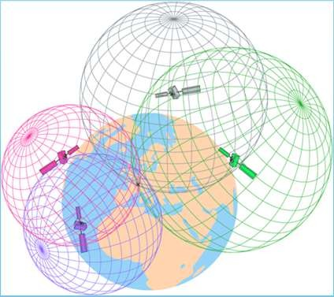
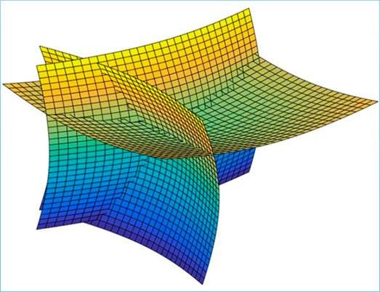
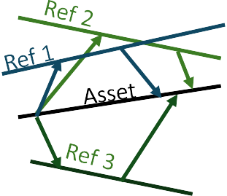
Position, Navigation G Time Protocol (PNTP)
(a) NTP (Stationary)
(b) PNTP (Stationary)
(c) PNTP (Moving Asset) (d) PNTP (Moving Reference, Asset)
Reference
t₂ t₃ |  | t₂,p₂,v₂,a | t₃,p₃,v₃,a |  | t₂,p₂,v₂,a | t₃,p₃,v₃,a | t₂,p₂,v₂,a | t₃,p₃,v₃,a
 |  | 2 | 3 |  | 2 | 3 | 2 | 3
Asset
t₁ t₄ t₁,p₁,v₁,a₁ t₄,p₄,v₄,a₄ t₁,p₁,v₁,a₁ t₄,p₄,v₄,a₄ t₁,p₁,v₁,a₁
t₄,p₄,v₄,a₄
Enables Spherical (TOA) and Hyperbolic (TDOA) positioning
Help support Kalman Filtering methods for PVA tracking and prediction
Can provide Compensation for Special and General Relativity
Accuracy is improved for packet rates >= 10/s
3+/4+ TOA/TDOA References
Spherical (TOA) Positioning: Hyperbolic (TDOA) Positioning:
3D Asset Position is at intersection of spheres 3D Asset Position is at intersection of hyperboloids

Slide 27











Position, Navigation G Time Protocol (PNTP)
Hierarchical
Stratum 1 Primary References
Stratum 2 Assets/References
Stratum 3 Asset
LEO
Satellite
Reference Receiver
Drone/UAV
ROV RF
UWB LPI/D RF
Links

Slide 28
What is a Time Scale Ensemble?
Inputs:
The statistical characteristics of each member
Measurements of times or frequencies of all members with respect to a reference clock
N-clocks produce N-1 independent inputs
Outputs:
Ensemble time offset from each clock, thus N outputs
N-1 inputs and N outputs requires an additional equation, such as optimizing stability
Physical realization of ensemble time
Advantages:
Minimize single points of failure
Output does not depend on a single device
Ensemble provides error detection
Theoretically the output is better than all contributors— and there are opportunities for improvement

Slide 29


Steered clock
Measurement system and time scale computation
 | Steering Control
Data from clock ensemble
Clocks are not
steered
Phase Stepper generates Scale as Offset from Clock
Steered output

Slide 30
Dynamic clock ensemble concept
Assumes correction of dynamic delays as well relativistic effects
Each platform clock measures and corrects its offset to ensemble time
Each platform produces the same ensemble time using the algorithm
Similar to the generation of TAI/UTC but in a dynamic environment
Analysis shows that ensembles can be successfully used on moving platforms, and there are research opportunities
Realizing the ensemble will have short-term issues due to latency in delivering the time epoch for steering
Relative Position Error between platforms translates to a measurement error, which degrades the stability of the ensemble
With highly dissimilar clocks, there are research opportunities to output the best of every clock
30

Slide 31
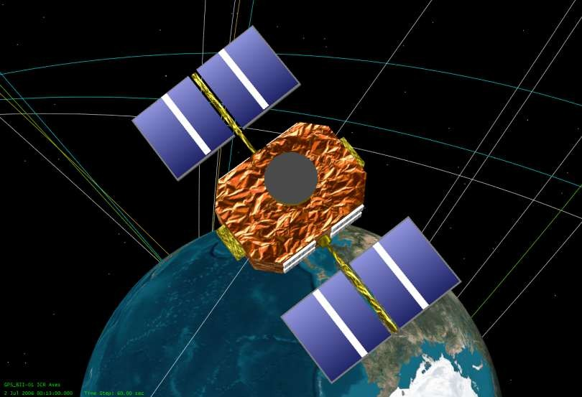
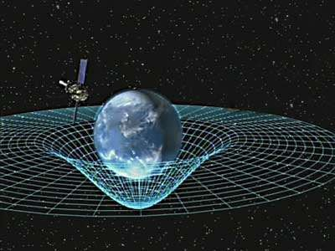
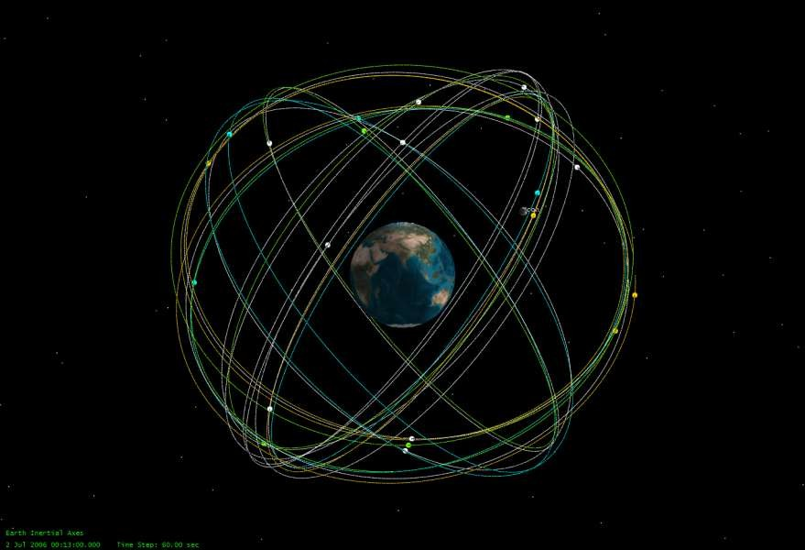
How clocks behave in space – relativity and environmental fluctuations
Initial approach for GPS: Relativistic corrections were made on board, clocks ran fast
Now GPS clocks are designed to run slow on the surface so in orbit they run at the correct rate
Goal is to have clocks behave as if they are in the laboratory but:
Satellites do not have a constant velocity:
Tidal forces (Sun and moon)
Eccentricity
Earth is not a perfect sphere, oblate
Solar wind and some atmospheric drag in low LEO
Fluctuations of the satellite environment
Thermal (in and out of sunlight)
Magnetic fields ( on board currents, earth’s field)
Vibrations and mechanical stability
Time transfer mitigates the need for long term stability
31

Slide 32
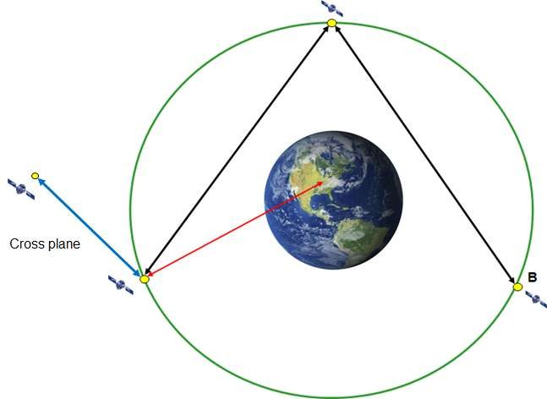
Satellite constellation synchronization: conceptual approach
Correct for clock relativistic effects
Transformation from proper time to coordinate time on each satellite (Can be done by design for circular orbits)
Transfer coordinate time and correct for propagation path asymmetry (multi-exchange TWTT protocol)
3 transmissions required by each platform to correct for motion and share measurements
Timeline in orbital plane at 7000 km above the Geoid
77 ms between platforms
At 7000 km altitude:
Chord length =23,171km
Platform moves 421 m during signal propagation nearly in a straight line.
Have communication link already established prior to conducting TWTT

Slide 33
Next steps in feasibility of dynamic ensembles
In laboratory ensembles the time comparison measurements occur at the same epoch
There is no latency when clock N is compared to clock M
Develop a quantitative analysis of airborne dynamics where the relative motion between platforms is random
Currently we require that the propagation delays and the path asymmetries are measured.
What is the behavior of the ensemble if the clocks in the network are compared at different epochs (measurement times)?
Conduct a simulation comparing Time Scale Algorithms and > 5 airborne platforms that includes:
Propagation effects, latencies, with varying ranges and range rates
Use 3+ diverse types of clocks
Time scale stability and how to handle the addition and subtraction of platforms
Include the effects of measurement noise
33

Slide 34
Research Ǫuestions
How do we optimally estimate delays among randomly moving networks of clocks?
Multiple two-way time transfer (TTT) measurements are needed, but what is optimal?
How do we share TTT results across the network in a timely manner
Can we optimize the PNTP structure to account for all delays and relativistic effects, thus minimizing needed measurements?

Slide 35
Research Ǫuestions
How do we generate an ensemble time that is more stable than all clocks, even when the statistics of the clocks are very different?
This has been demonstrated when clocks are similar: e.g. all Rb clocks
Can we similarly optimize performance if we have clocks as different as a Ǫuartz LO and a GNSS receiver
Ǫuartz LO has very good short-term, but poor long-term stability
GNSS receiver has relatively poor short term, but very good long term
Typically, we lock an LO to GNSS to obtain the best short-term and long-term
Can we have many diverse clocks and get optimal performance of the ensemble?

Slide 36
Research Ǫuestions
How do we optimize performance of a distributed ensemble with clocks on moving platforms?
For satellites in orbit, the latency can be large. For LEO satellites ~ 10’s of ms. For MEO to GEO satellites perhaps 0.1 s.
Can we optimize the filtering of range errors by the ensemble?

Slide 37
Research Ǫuestions
4. Ensembles of ensembles– can these provide improved
resilience and performance, for example, in Cyber-Physical
Systems?
In uncertain measurement environments
Autonomous vehicles
Moving platforms
Battlefield environments
Synchronization Islands
GPS denied environments
e.g. urban canyons
clusters of drones, aircraft, boats, soldiers
Assuming better sync accuracy and reliability in islands, worse in the
ensemble of ensembles

Slide 38
Research Ǫuestions
Clocks entering and leaving ensembles
Estimating Clock Stats
In uncertain environments clock stats must be estimated adaptively
Short term behavior can be converged on relatively quickly
Long-term behavior takes a long time to learn accurately– determines long-term behavior of ensemble
A high-weight clock leaving unexpectedly can disrupt the ensemble time and frequency

Slide 39
Research Ǫuestions
Clocks entering and leaving ensembles
Disruption of the Ensemble
Short term behavior can be converged on relatively quickly
Long-term behavior takes a long time to learn accurately– determines long-term behavior of ensemble
A high-weight clock leaving unexpectedly can disrupt the ensemble time and frequency

Slide 40
Conclusions
Time transfer across moving platforms requires more research
Optimally determine changing delays– cannot assume symmetric!
Minimize needed TTT measurements
Communicate PNTP data to all members
Distributed Time Scale Ensembles Across moving Platforms
Advantages
Optimize predictability
Improve resilience
Optimizing an algorithm for highly varied clocks on moving platforms in
uncertain environments
Needs more research– Can expand on previous work
Has conflicting requirements
We would like collaborators!

